Slide 1
Mean Reversion systems during COVID-19 (Black Swan event)
Use of disruptive technologies to enhance traditional models.
Luis Román Alcaide

Slide 2
“Sometimes it’s the people no one imagines anything of who do the things that no one can imagine.”
Alan Turing.

Slide 3
01
02
03
Algorithm
Context
Results
INDEX
Mean Reversion strategy with Bollinger Bands vs. Buy & Hold.
COVID-19 event : Black swan
How to improve those results? Quantum computing applied to finance

Slide 4
Algorithm
01
Mean Reversion strategy with Bollinger Bands vs. Buy & Hold

Slide 5
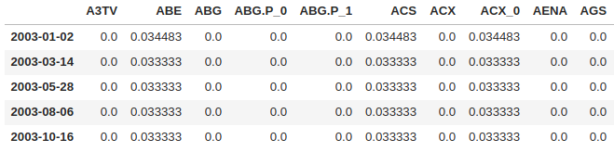


Allocator Algorithm : pipeline
Input
Execution
Output
100.000 €
The output is similar to an index, or an ETF.
On a daily basis, we indicate the percentage of capital in which we want to be invested for each asset in the index
All sales operations will be carried out at the opening auction
All purchase operations will be carried out at the closing auction
We will send the orders before the opening (between 7 and 9 in the morning).
From the endpoint, we obtain all the historical data by ticker and date range.
We execute the algorithm daily, sending the resulting orders to the broker.
We will send the orders before the opening (between 7 and 9 in the morning).

Slide 6
First of all, a few key concepts…
Sharpe Ratio: it measures the return of an investment relative to its volatility, adjusting for the underlying cost of capital. In other words, it indicates how well an equity investment performs in comparison to the rate of return on a risk-free investment ( e.g. U.S. treasury bonds or bills)
Jensen’s Alpha: is a risk-adjusted performance measure that represents the average return on a portfolio or investment, above or below that predicted by the capital asset pricing model (CAPM), given the portfolio's or investment's beta and the average market return. In other words, it is the difference in how much a person returns vs. the overall market (benchmark).

Slide 7
So, what is considered a good Sharpe ratio or Jensen’s alpha?
A good Sharpe ratio indicates a high degree of expected return for a relatively low amount of risk.
Usually, any Sharpe ratio greater than 1.0 is considered acceptable to good by investors. A ratio higher than 2.0 is rated as very good & a ratio of 3.0 or higher is considered excellent.
Jensen's measure is one of the ways to determine if a portfolio is earning the proper return for its level of risk.
If the value is positive, then the portfolio is earning excess returns. In other words, a positive value for Jensen's alpha means a fund manager has "beat the market" with their stock-picking skills.

Slide 8
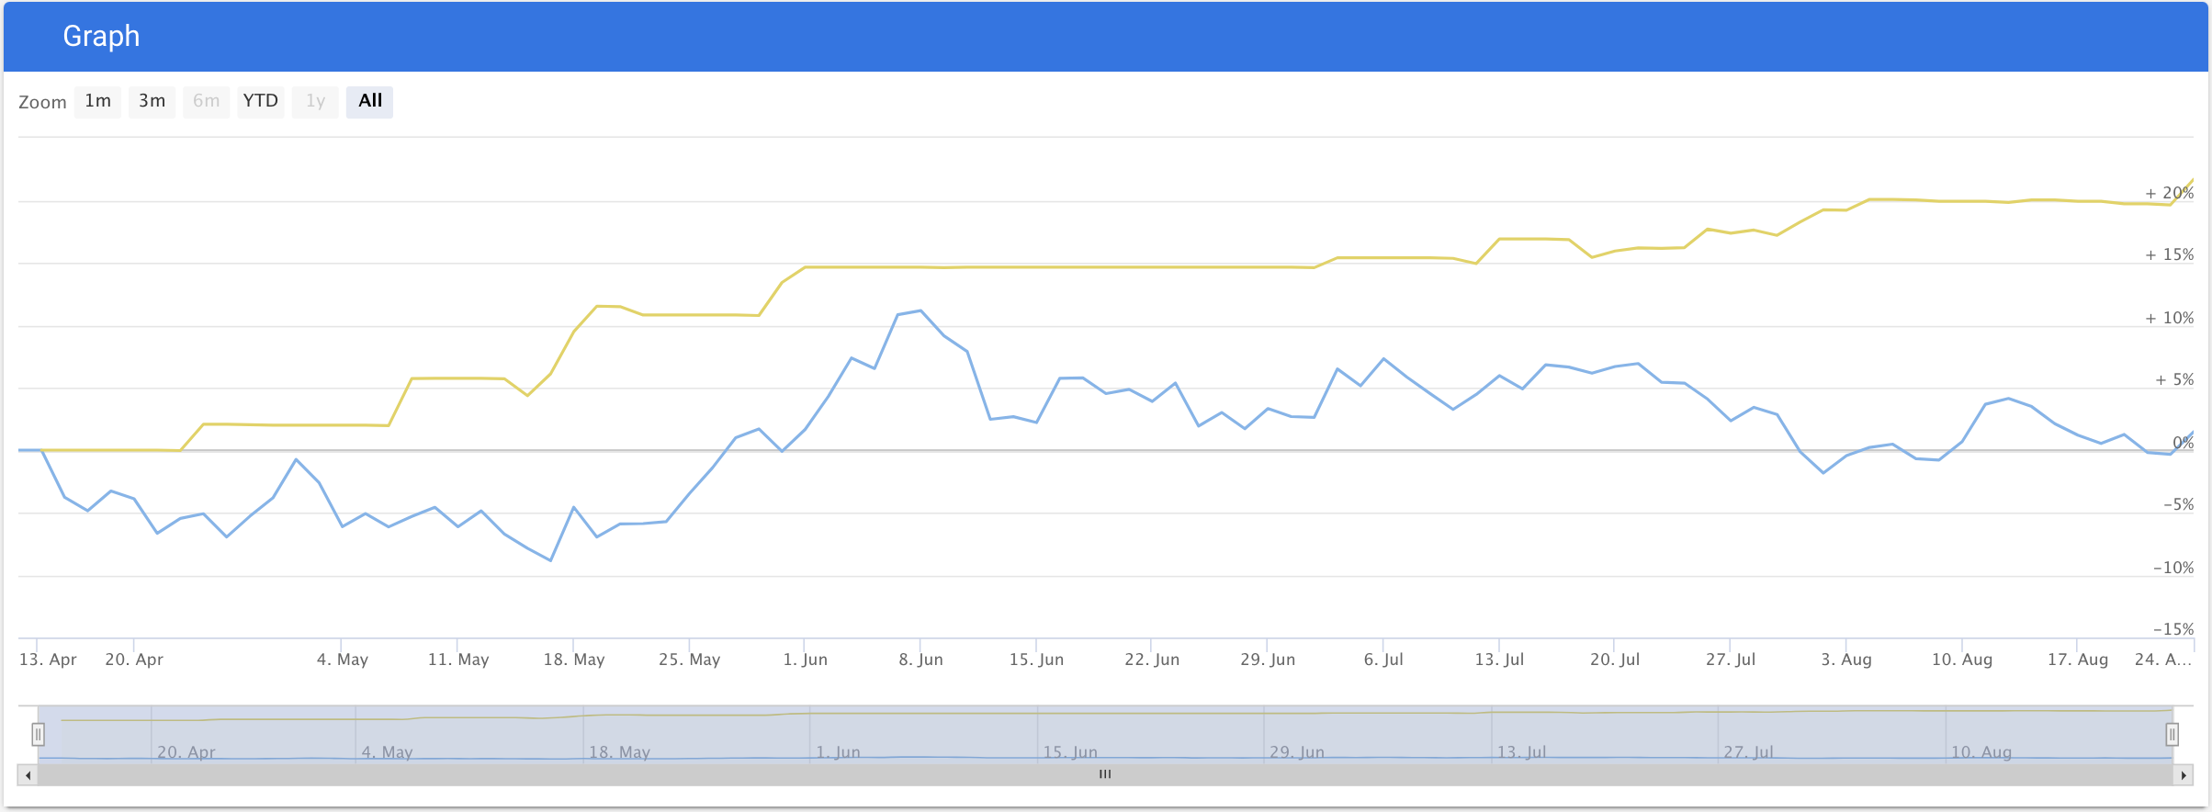

Mean Reversion with BB
Algorithm
IBEX 35 TR
Hedge Fund numbers!!! Great... But why?
ANNUALIZED RETURN : 72 % SHARPE RATIO : 4.57 JENSEN’S ALPHA : 72%

Slide 9
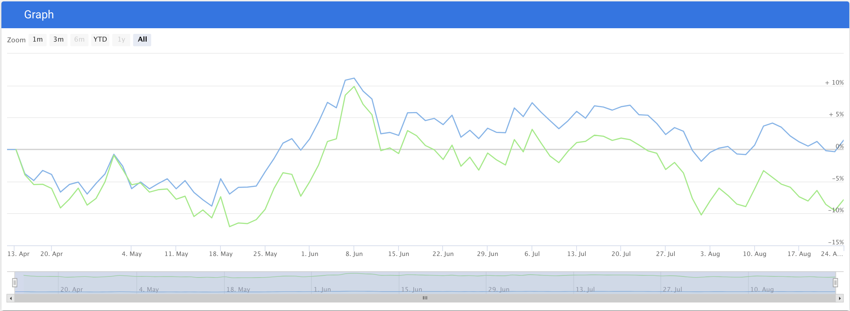

Buy & Hold
Algorithm
IBEX 35 TR
Why those bad numbers
in such a profitable strategy?
ANNUALIZED RETURN : -20.2 % SHARPE RATIO : -0.62 JENSEN’S ALPHA : -20.2%

Slide 10
Context
02
COVID-19 event : Black swan

Slide 11

Why those results ? Black Swan phenomenon
This algorithm was executed during COVID-19 crisis which is a Black swan event, like 11-S or Brexit.
IBEX 35 has met all key features of Black Swan events which are the following:
Be an unexpected event, difficult to predict and that constitutes a surprise.
Have a big impact on the economy and politics.
In hindsight, be predictable
Mean reverting strategies are effective during Black Swan events, e.g. IBEX 35 performance during COVID-19 crisis.

Slide 12
Results
03
How to improve those results? Quantum computing applied to finance

Slide 13
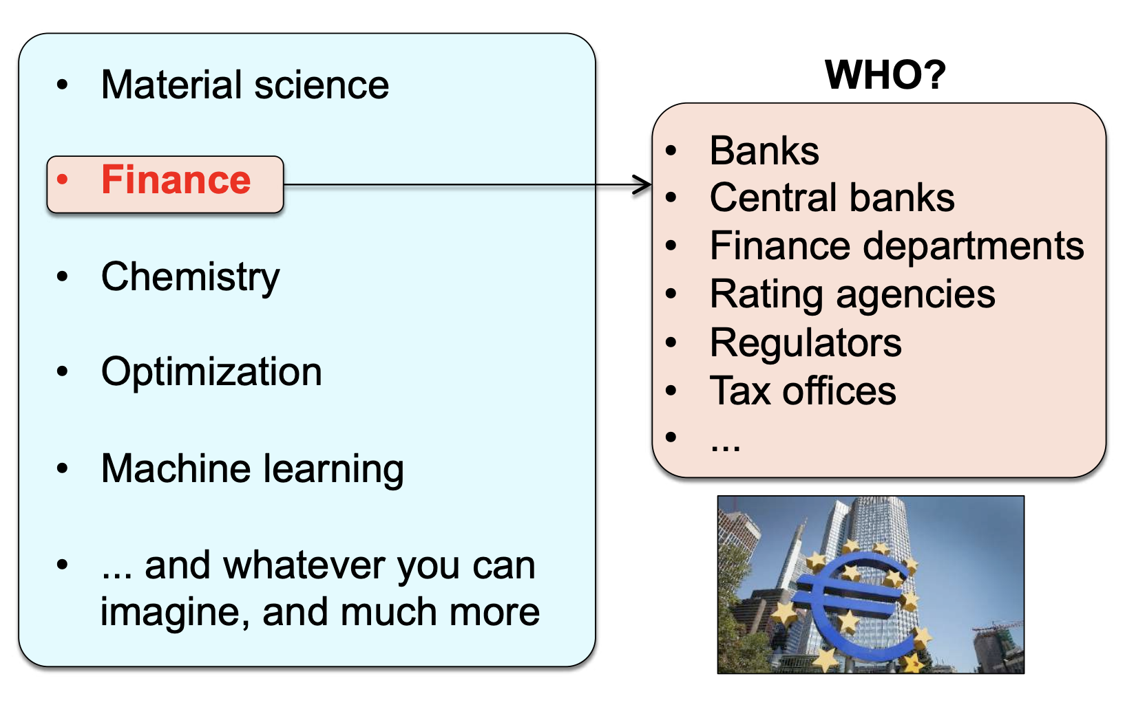
Quantum computing applied to finance - Overview

Slide 14
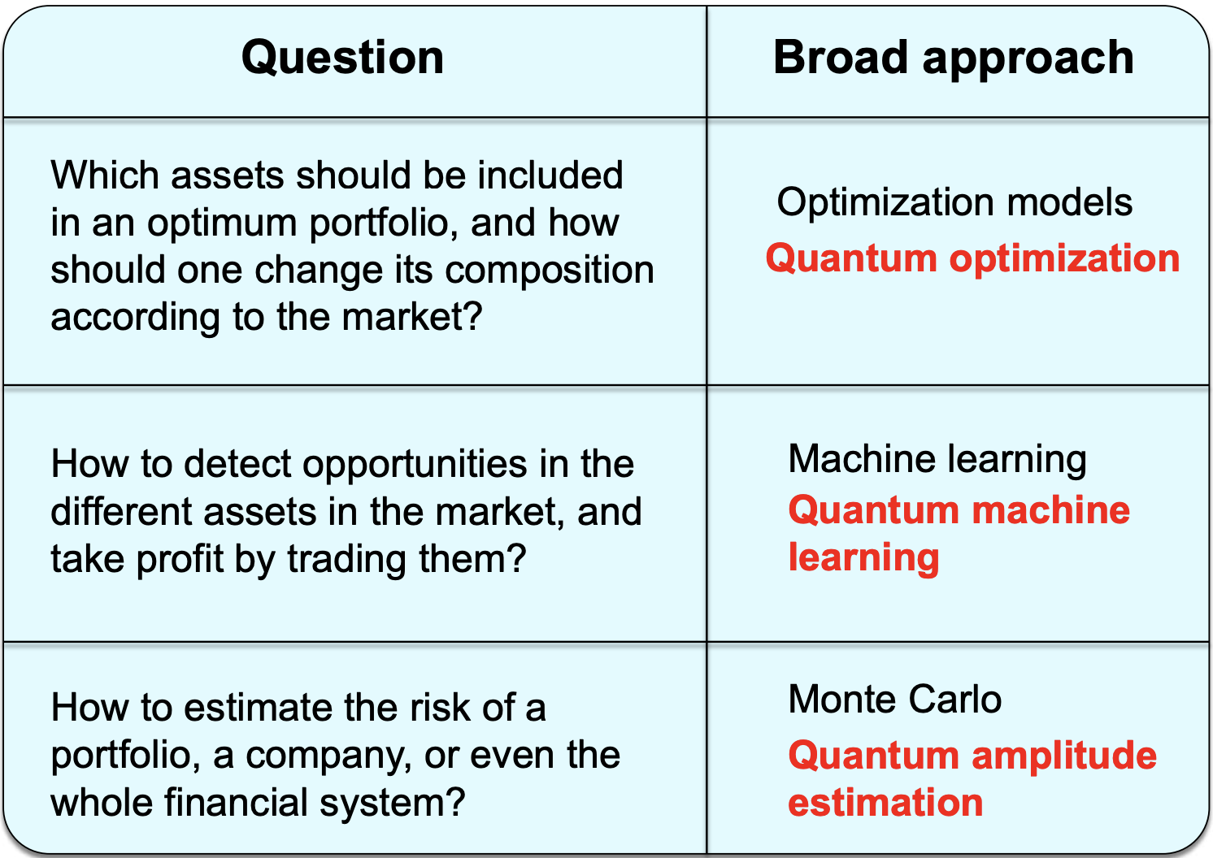
Quantum computing applied to finance – Quantum optimization (I)

Slide 15
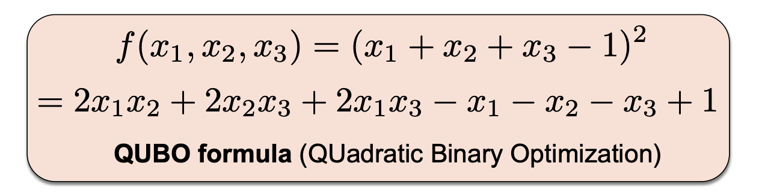
Quantum computing applied to finance - Quantum optimization (II)
We need a tool to solve optimization problems (i.e., finding the best solution, or at least a good one, from many posible options) => in physics: energy minimization problem

Slide 16
Quantum + AI
3 ways quantum computers could change the future of AI:
Building Better Models: An industry like finance, is nearly at the end of its classical computing rope. It requires complex models that classical computers just can’t generate. Quantum computers, have the potential processing power to model the most complex situations.
More Accurate Algorithms: more efficient reinforcement learning models. Training accelaration using quantum computers. Less time consumption and more computing workload.
Using Multiple Datasets: quantum computers could handle the integration of different datasets for much quicker and easier analysis.

Slide 17
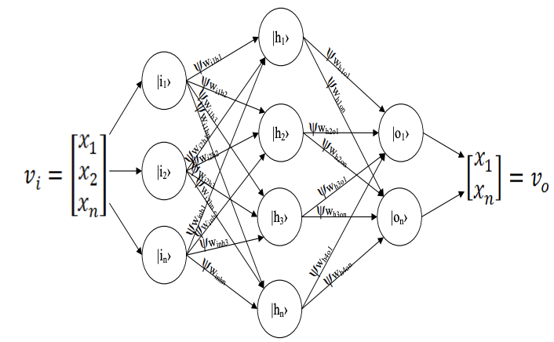
Quantum Artificial Neural Network (QANN) (I)
The structure of a quantum feed forward artificial neural network does not differ from a normal one, but the concept of linear superposition is one of the differences that can be described graphically by the picture.

Slide 18
Quantum Artificial Neural Network (QANN) (II)
Is it posible to predict financial turnmoils with QANNs?
Overall Network Superposition: As the linear superposition indeed dictates that any possible configuration of each Qbit exists at once and as, related to the example QANN, any of these (weight) configurations has numerous configurations of thresholds, an impracticality occurs, namely the coexistence of identical configurations in one superposition.
Thus, one configuration of a quantum artificial neural network must include both the weights and the neuron thresholds.

Slide 19
CONCLUSIONS
Mean reverting strategies are very effective during Black swan events
Use of ML, DL and Quantum will enhance traditional models solving complex models.
Optimization and allocation are two main aspects in which quantum would make a great difference.
QANNs might predict financial turnmoils derived from Black swan events.
Motivation
Using less time = earning more money

Slide 20
CONTACT
https://www.linkedin.com/in/luis-rom%C3%A1n-383b12b5/
https://twitter.com/luisalro94
+34 620 04 50 09
luisalroman94@gmail.com

Slide 21
Thank you for your time!

